Slide 1
Direct Sequence spread spectrum
It Is Used For Digital Signal .
The Direct Sequence Spread Spectrum (DSSS) Technique Expand The Bandwidth Of The Original Signal.
DSSS Replace Each Data Bit With N Bits Using a Spread Code Called Chipping Code .
Direct Sequence Spread Spectrum(DSSS) (XOR) With Chipping
Sequence.

Slide 2
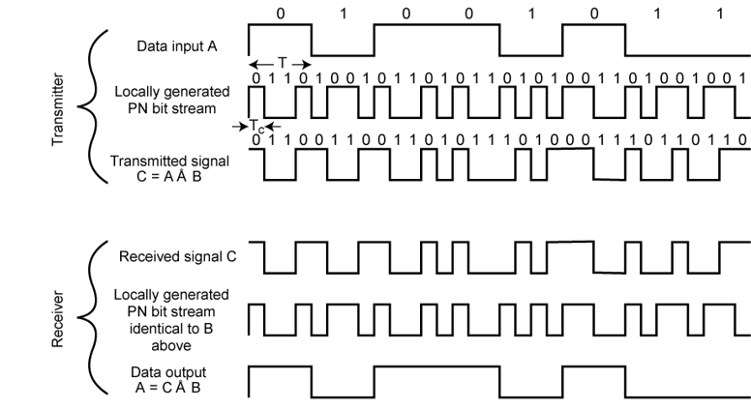
DIRECT SEQUENCE SPREAD SPECTRUM EXAMPLE

Slide 3
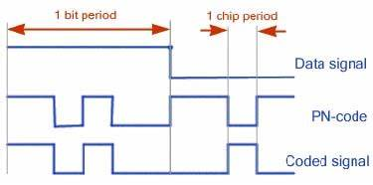
tb : bit period
tc : chip period

Slide 4
Each user bit has a duration tb , the chipping sequence consists of smaller pulses ,called with a duration tc
Spreading factor s =tb/tc gives the bandwidth

Slide 5
Transmission and receiving using dsss
Spread spectrum signal
Transmit signal
User data
x
modulator
Chipping sequence
Radio carrier
transmitter

Slide 6
Transmission process
Spreading Of The User Data Sequence(Digital Modulation)
The Spread Signal Is Then Modulated With a Radio Carrier

Slide 7
correlator
product
Received signal
Sample sum
Low pass filter
data
demodulator
x
integrator
decision
Radio carrier
Chipping sequence
Receiver

Slide 8
Receiving process
The Receiving Signal Is First Demodulated Using The Same Carrier Frequency Used In Sender Generates Lowpass Filter Signal
The Receiver Has To Know The Original Chipping Sequence For Dispreading The Data , So Sequence At The Sender And The Receiver Have To Precisely Synchronized.
The Receiver Calculates The Product Of A Chip With The Incoming XOR Signal.
An Integrator Adds All These Products . The Products In An Integrator Is Also Called Correlator
Finally In Each Bit Period A Decision Unit Decides If This Sum Represent A Binary1or a 0 .

Slide 9
advantage
The main advantage of DSSS technology is the ability to protect signals from interference and jamming.
The primary advantage of the direct-sequence spread spectrum is that security is enhanced without any additional hardware.

Slide 10
disadvantage
The Acquisition Time Is Too Large With The Serial Search System. Because Of That DSSS System Is Slow.
DSSS System Required Very High Bandwidth. But This Bandwidth Is Less Than The FSSS System .
The Variable Distance Between The Transmitter And Receiver, Affect The Synchronization.

